Slide 1
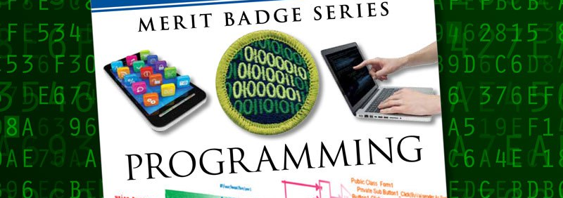
Programming
Troop 1776
Winter Camp – January 2019

Slide 2
“There are only 10 kinds of people in the world: those who understand binary and those who don’t.”
~ anonymous

Slide 3
1a
“There are only 10 kinds of people in the class: those who have shown me a current Cyber Chip and those who did not.”
~ Mr. Zeigler

Slide 4
Safety
1b
Repetitive Stress Injury (RSI)
Eyestrain

Slide 5
1b

Slide 6
First Aid and Prevention
1b
Take Breaks - Eyes
Typing breaks
Rest breaks
Exercise breaks

Slide 7

Hidden Message…

Slide 8
What is a Program?
Set of instructions
Tells a processor how to do a particular task

Slide 9
What is Programming?
Converting ideas into instructions
Understand the purpose of the program [Requirements]
Break instructions down into steps [Design]
Translate design into language [Coding]
Verify actual results match expected results [Testing]

Slide 10
Fun Facts
There are currently over 1.2 million programmers and software developers in the United States
More than 2,500 programming languages have been developed

Slide 11
History of Programming Languages
2a
Jacquard Loom
Punch Cards

Slide 12
Ada Lovelace
2a
1843
Ada Lovelace credited with the first computer programming language; wrote an algorithm for the Analytical Engine (early mechanical computer)

Slide 13
2a

Slide 14
John von Neumann
2a
Conditional Control Transfer
If <condition> then <action a> else <action b>
if <raining> then <stay inside> else <go outside>
While <condition> do <action>
while <raining> do <hold umbrella>
subroutines, libraries, reusable code
go outside:
stand up
walk to the door
open the door
walk out the door
close the door
Programming Pioneer
1903-1957

Slide 15
Assembly Language
2b
Assembly language is hardware specific and is compiled into machine language (binary code)

Slide 16
High-Level Language
2b
An advanced programming language
Easier for humans to understand
Not limited to single processor / machine

Slide 17
Early Important Languages
3a 1-6
1950s
FORTRAN (1957)
John Backus (IBM)
Formula Translating System
High performance computing – weather and climate modeling
Computationally intensive
LISP (1958)
John McCarthy (MIT)
Recursion and list-processing
Artificial intelligence
COBOL (1959)
Common Business Oriented Language
Primarily used in business, finance, and admin systems
1960s-1970s
BASIC (1964)
John Kemeny and Thomas Kurtz (Dartmouth)
Beginner’s All-purpose Symbolic Instruction Code
Based on FORTRAN II
Pascal (1970)
Niklaus Wirth
Developed to encourage good programming practices
Structured programming
Data Structuring
C (1972)
Dennis Ritchie (AT&T Bell Labs)
Developed to implement Unix OS
One of the most widely used programming languages

Slide 18
Object-Oriented Programming
Different than procedural programming
Logical grouping / modularization of commands
Allows for re-use
Simula (1960s)
Smalltalk (1970s)
C++ (1983)
Java (1995)

Slide 19
The World Wide Interwebnets
HTTP
New languages and markup
HTML
JavaScript
PHP
Static vs. Dynamic

Slide 20
Other Programming Languages
3a 1-10
ADA (1980)
US Department of Defense and UK Ministry of Defence
Wanted standardized language
Objective-C (1983)
Apple programming OSX and iOS
PERL (1987)
Python (1991)
Official language of Raspberry Pi
Ruby (1993)
Web application development
Java (1995)
Android development
PHP (1995)
WordPress, Drupal
>81% of all websites
JavaScript (1995)
Dynamic web pages

Slide 22
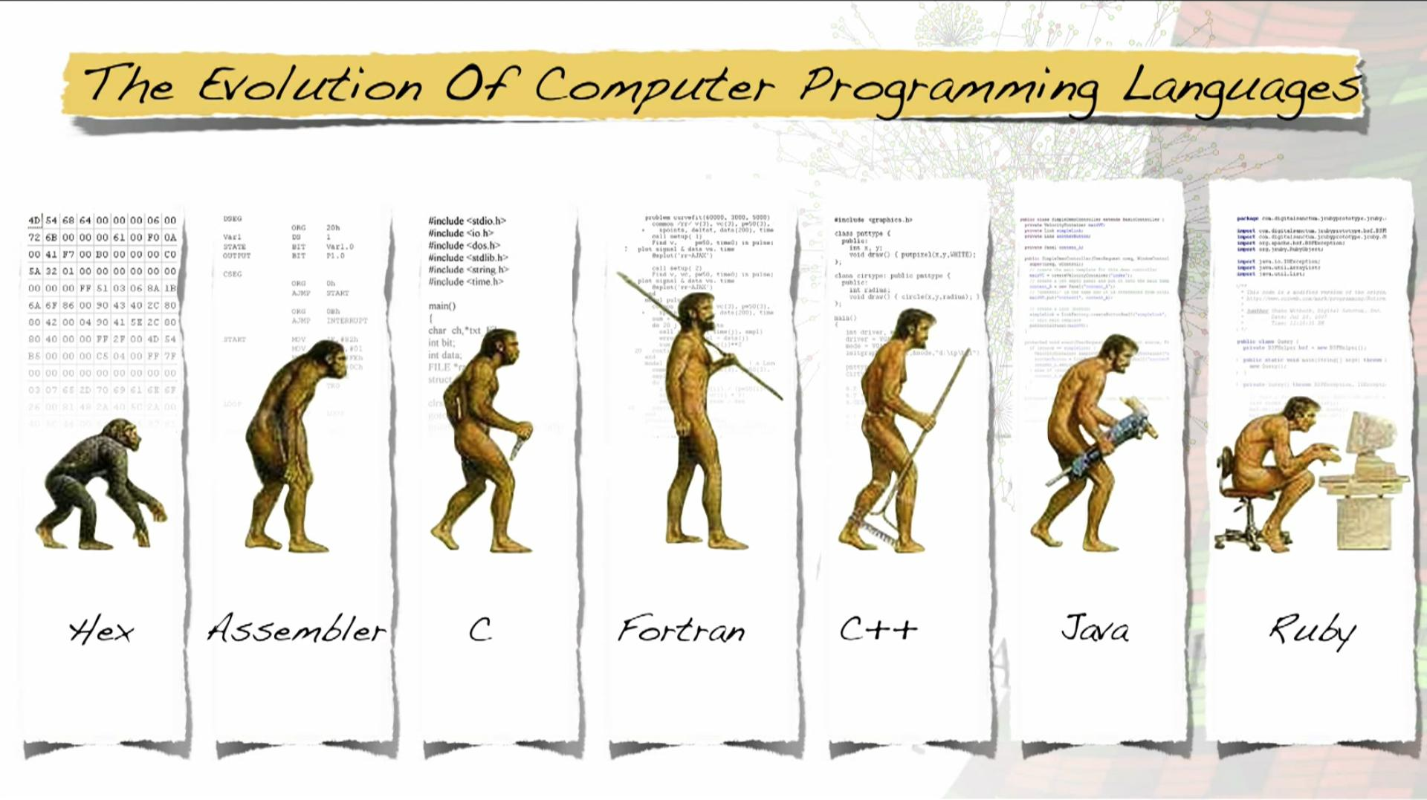

Slide 23
Where is Programming Used?

Slide 24
Programmed Devices
3b
Mobile Phones
Tablets
DVD / Blu-ray
Game Consoles
Alarm Clock
TV / DVR
Cars
Watch
Fitness Trackers
GPS
Coffee Pot
Microwave

Slide 25
Business Applications
Retail
Point-of-sale systems
Receipt printers
Card readers
Cash drawers
Warehouses
Inventory control
Temperature control
Accounting
Accounting systems to track money
May be integrated with point-of-sale and inventory systems
Administrative
Communication systems
Word processing
Spreadsheet applications

Slide 26
Factory Automation
Programmable Logic Controller (PLC)
Designed specifically to control machines
Machines themselves are not programmed
Can be programmed to do the same task over and over again
Durable
Work in wide temperature ranges
Work in harsh conditions

Slide 27
History of PLCs
Factories were controlled by relays; on or off
Lights
Conveyor Belts
Fans
Ovens
Hundreds and thousands may be used
Cabinets full of relays and wires
Bulky and hard to fix
Changing process was hard; required re-wiring
Modular Digital Controller (MODICON; late 1960s)
Simple computer; replaced relays

Slide 28
Programming PLCs
Different than other kinds of programming
Several ways to be programmed
Ladder Logic – most popular
Resembles a relay wiring diagram

Slide 29
Where else can we use Programming?

Slide 30
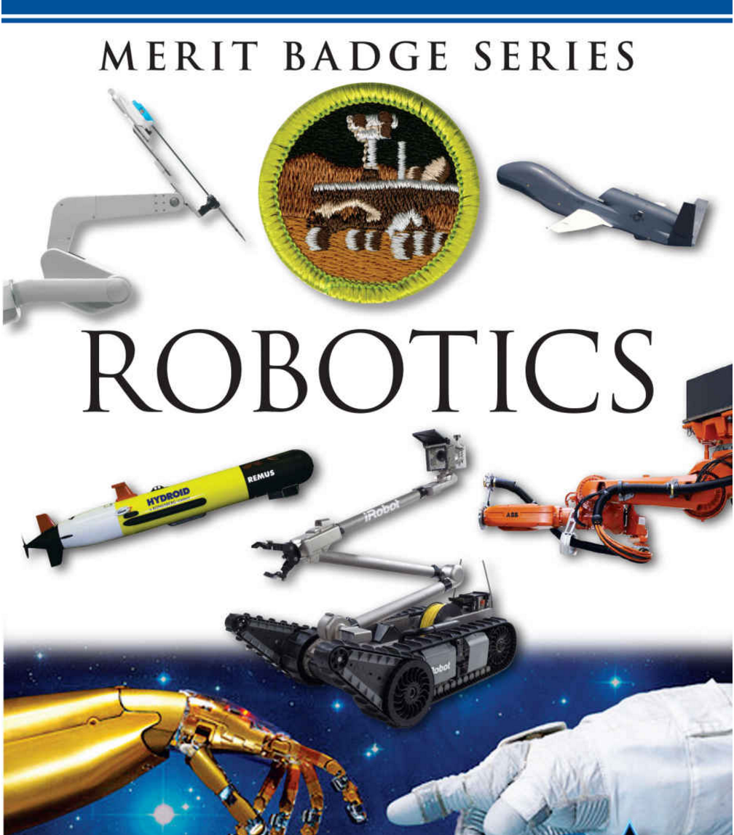

Slide 31
Programming for the Internet

Slide 32
Web Applications

Slide 33
Databases

Slide 34
Structured Query Language (SQL)
Data Definition Language (DDL)
Definition of database structure
Data access control
Data Manipulation Language (DML)
Query language to create, read, update, and delete (CRUD)
SELECT
INSERT
UPDATE
DELETE

Slide 35
Version Control Systems

Slide 36
4

Slide 37
Copyrights
4a
Protects a particular expression of an idea
Automatically available once idea is created and physically stored
Protects against others making copies of images, code, etc.

Slide 38
Patents
4a
Protects useful and innovative:
Processes or methods
Machines
Manufactured items
Not automatic. Must be applied for with the US Patent and Trademark office
Lengthy process; often requires services of a patent attorney or agent

Slide 39
Trademarks
4a
Protects a word, phrase, symbol, sound or color – the “mark”
Identifies and distinguishes the product or service
Mark (™) is a notice that you are claiming trademark rights.
® shows that a mark has been registered with the US Patent and Trademark office

Slide 40
Trade Secrets
4a
Protects commercially valuable information
Owner has taken strong measures to maintain secrecy
Does not protect against the use if developed independently or if information was acquired legitimately
Everyone with access must maintain the secrecy.

Slide 41
License vs. Owning Software
4b
License – can use software within certain restrictions, for a period of time at a specific location.
Owning - more ability to do what you want with software that you have developed.

Slide 42

Understanding the Differences
4c
OPEN SOURCE
Source code:
Available to public
Modifiable
May be redistributed
Community of developers
Free
Support can be community based or paid
Open Source Initiative (opensource.org)
FREEWARE
Free
Developer chooses free distribution
Source code not available
Distribution from developer site only
SHAREWARE
Free for limited/trial period
Developer owns rights
Source code not available
No collaborative community
Payment often required

Slide 43
Three Careers in Programming
6 Careers
Education
Training
Experience required
Why does this interest you?

Slide 44

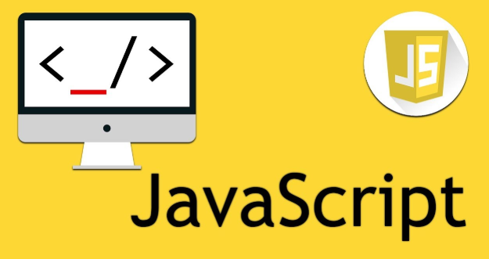
Three Programming Projects
5 Projects

Slide 48
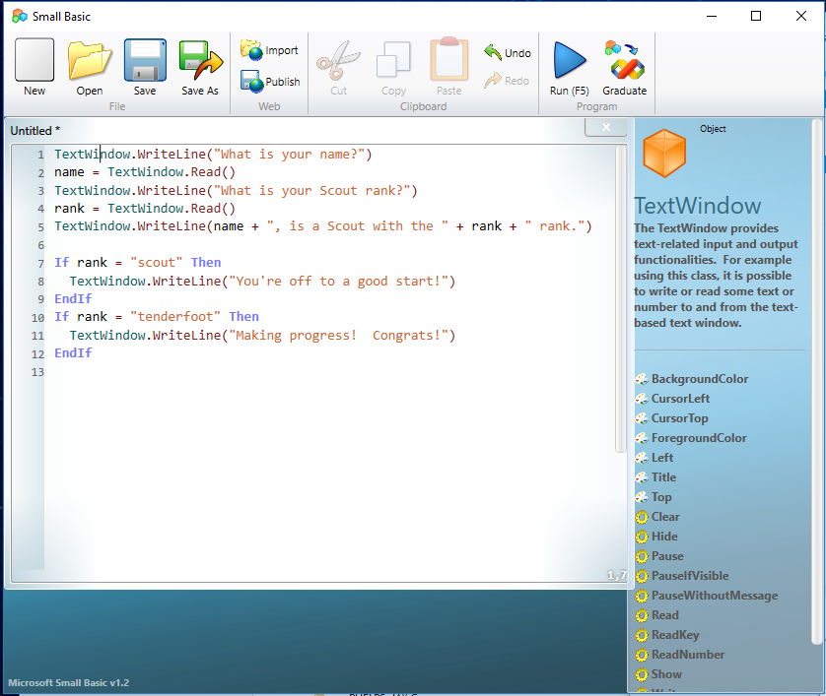
Small Basic
5a

Slide 49
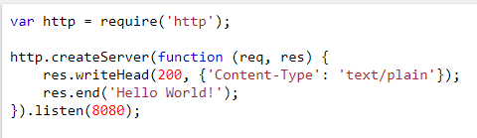
JavaScript NodeJS Sample Code
5b

Slide 50
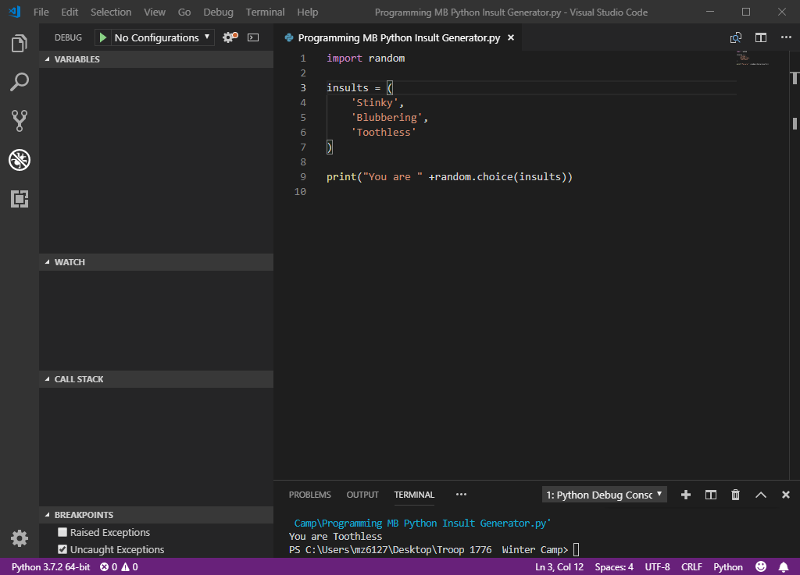
Python
5c

Slide 51
How to Program a Conversation with Alexa! (Python & AWS Lambda) - Part 1 https://www.youtube.com/watch?v=sj7NqS7yytw How to Program a Conversation with Alexa! (Python & AWS Lambda) - Part 2 https://www.youtube.com/watch?v=-MOvJ3eklr0 developer.amazon.com/alexa-skills-kit https://github.com/KeithGalli/Alexa-Python
Python
And
Alexa

Slide 52
Programming Resources
Small Basic: www.smallbasic.com
Javascript: https://javascript.info
Raspberry Pi: www.raspberrypi.org
Python Programming: www.pythonprogramming.net
Minecraft Python Raspian: https://projects.raspberrypi.org/en/projects/getting-started-with-minecraft-pi
Code Academy: www.codecademy.com
Code.org: www.code.org
Learn Python: www.learnpython.org
Learn Vue 1: laracasts.com/series/learning-vue-step-by-step
Learn Vue 2: laracasts.com/series/learn-vue-2-step-by-step
Killer PHP: www.killerphp.com
Learn C++: www.learncpp.com
Scratch: scratch.mit.edu
W3 Schools: www.w3schools.com

Slide 53
Additional MB Sample Projects
Checkout from GitHub
git clone https://github.com/ericjsilva/programming-mb-python.git
git clone https://github.com/ericjsilva/programming-mb-php.git
git clone https://github.com/ericjsilva/programming-mb-javascript-vuejs.git
https://github.com/ericjsilva/programming-mb-python https://github.com/ericjsilva/programming-mb-php https://github.com/ericjsilva/programming-mb-javascript-vuejs

Slide 54
Contact Info and Credits
Marvin Bobo
Marvin.bobo@gmail.com
Mark Little
4markl@gmail.com
Troy McSimov
troy@mcsimov.com
Mark Zeigler
mziggy@swbell.net
Presentation Credits – modified from Eric Silva of Hawk Mountain Council – ericjsilva@gmail.com

